Slide 1
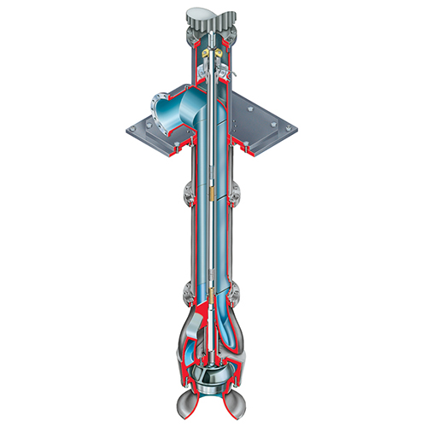
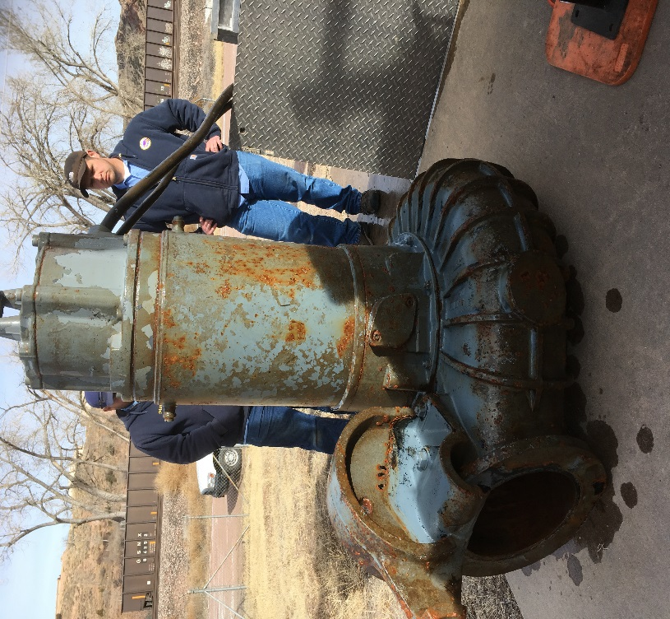
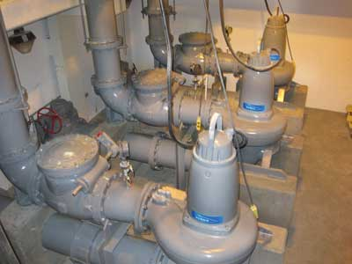
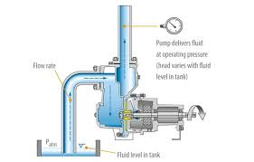
Lift Station Maintenance
Brandon Cole & Peter Botsonis

Slide 2
Lift stations
Pumps, Controls, and Maintenance
Types of lift stations that we deal with.
  Submersible
  Dry pit
  Suction lift
  Vertical solid handling.
  Simplex, duplex, triplex…. etc.

Slide 3
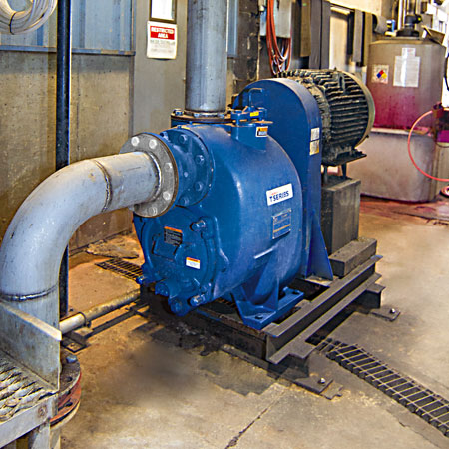
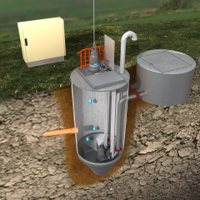
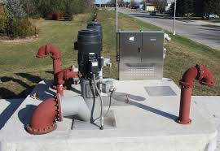
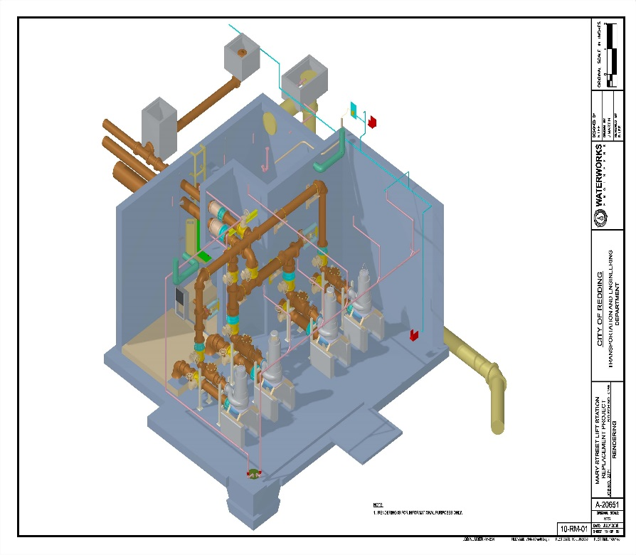
Types of Lift stations

Slide 4
Operating Sewage lift stations
Setting in a low spot in sewage collections systems, a lift station will take the waste stream from residential areas, business, agriculture…. The list goes on. All lift stations have their obstacles to overcome.
How far to pump (Friction losses)
Elevation Change (Static head)
How much to pump
Type of Waste
Power
Break Downs
Customers

Slide 5
What Happened
You get the dreaded call from the auto dialer.
  You show up to the lift station and the alarm light is going off. What is your first move?
  Silence the audible alarm so you can think.
  Check the control panel display or alarm indicator to determine the nature of the alarm (e.g., high water level, pump failure, or power outage).
  The pumps are running but not moving any water?
  ??
  The station pumps are moving water but not enough to stop it from backing up and tripping won't won't alarm.
  ??
  The pumps are running continuously and won't shut off.
  ??
  The pumps are running but making allot of noise and the flow is non existent or reduced in half.
  ??

Slide 6
Troubleshooting Common Issues
1. Pumps Not Running
- Verify incoming power.
- Check for blown fuses or tripped breakers.
- Confirm control panel settings and HOA switch position.
- Inspect floats or sensors for debris preventing activation.
2. Pump Running Continuously
- Check if the level control floats are stuck.
- Ensure the discharge line isn’t blocked.
- Inspect check valves for leakage causing recirculation.
3. Pump Overheating
- Verify ventilation and cooling systems.
- Check for excessive debris or blockages in the pump.
- Inspect bearings and motor for signs of wear.

Slide 7
What is Preventive Maintenance?
Preventive Maintenance
Preventative Maintenance- maintenance that is regularly performed on a piece of equipment to lessen the likelihood of it failing. It is performed while the equipment is still working so it minimizes the untimely downtime

Slide 8
Benefits of Preventive and Predictive Maintenance
Less likely to pollute the environment
Reduces the chances of complete machine breakdowns.
Longer asset life.
Improved efficiency (assets in good repair tend to operate better and saves money on utilities)
Increased safety
Reduces the chance of emergency repair calls.
Helps the owner make educated decisions on what spare parts to keep on the shelf
Saves on man hours (overtime) & stress on personnel

Slide 9
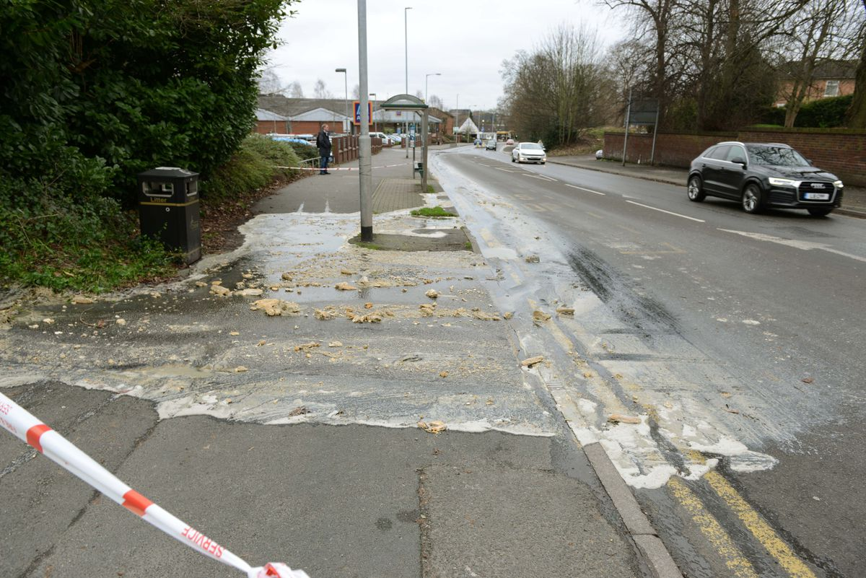
Importance of Maintenance
Environmental Safety Costs
The term ‘if it’s not broken, don’t fix it’ still applies to many industries. However in the sewage business, broken means more then just down time and lost revenue. It means ….OH SH!! Houston we have a problem!

Slide 10
Let’s look at the station itself

Slide 11
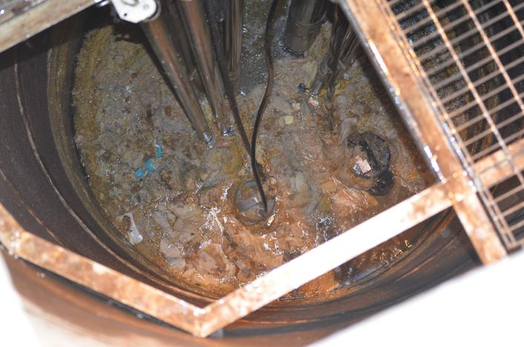
Fats, Oil & Grease (FOG)

Slide 12
What can FOG do to a station?
Induce additional amounts of H2S
Premature wear on equipment
Prevents floats & other level control devices from functioning properly
Can eventually cause clogging/suction restriction on pumps

Slide 13
How to resolve
Vac Trucks
Chemicals
Mechanical Piece of Equipment such as an aerator or mixer

Slide 14
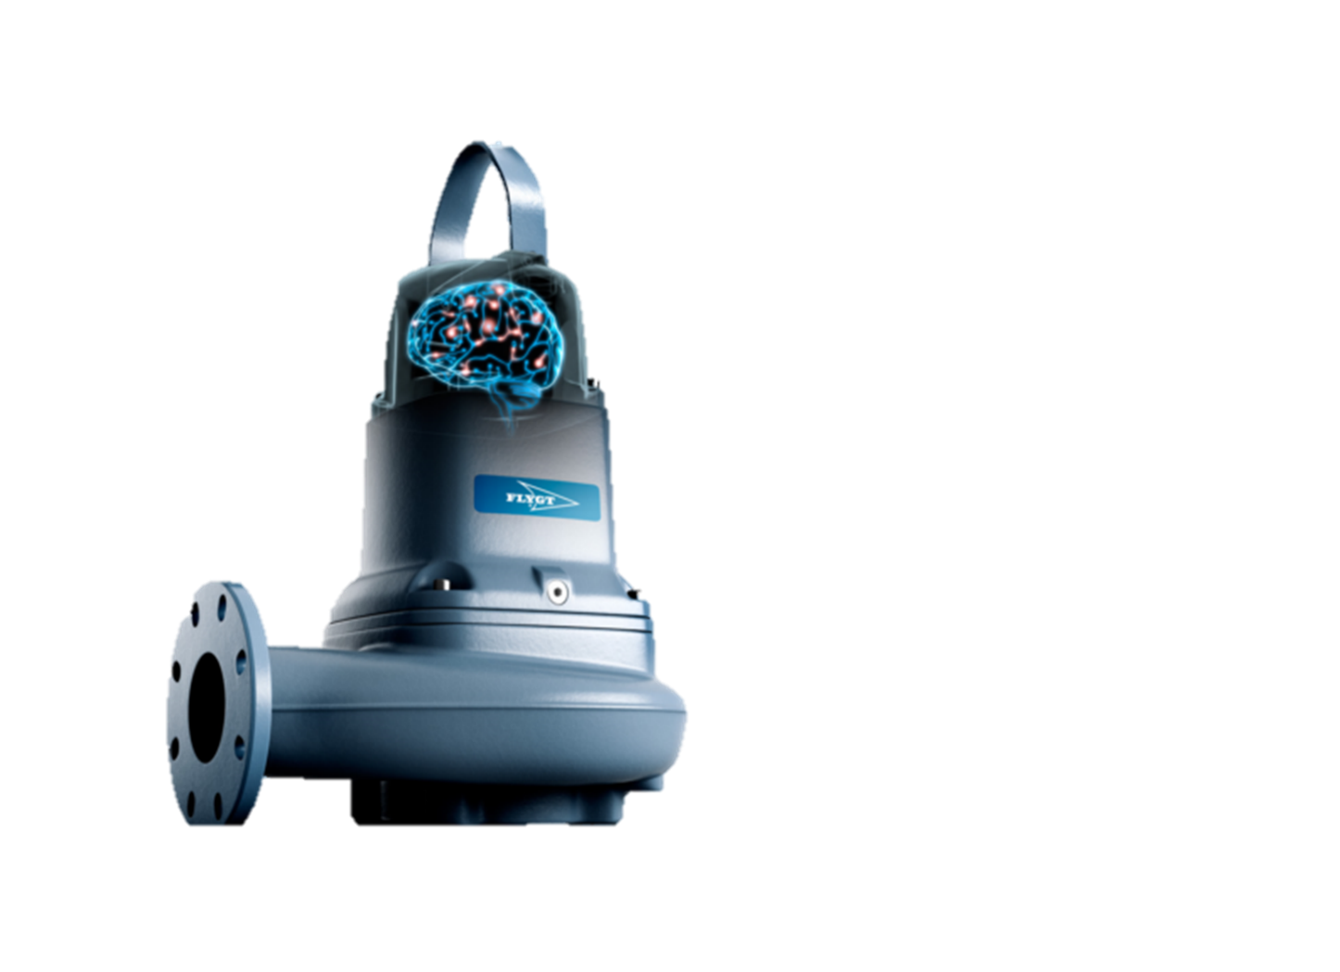
Pumps

Slide 15
What to check for
Check amp draw (done by qualified trained personnel)
Check voltage (incoming & load voltage)
Check oil for contamination
Check impeller clearance for excessive wear
Check pump casing for excessive wear & corrosion
**Always consult your equipment’s O&M manual regarding periodic and overhaul recommendations.

Slide 16
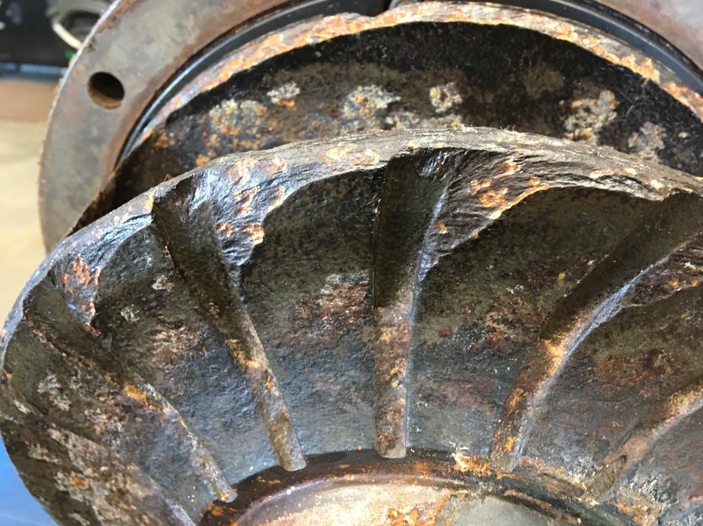
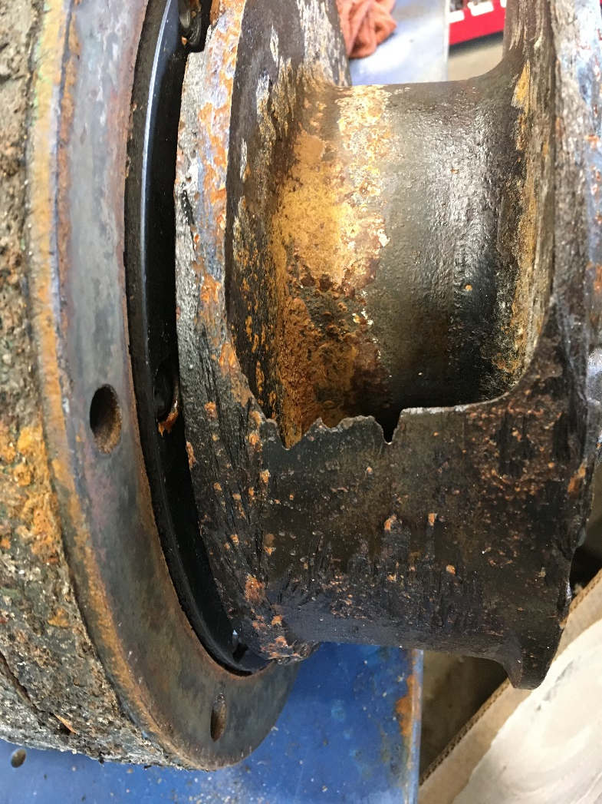
What to check for

Slide 17
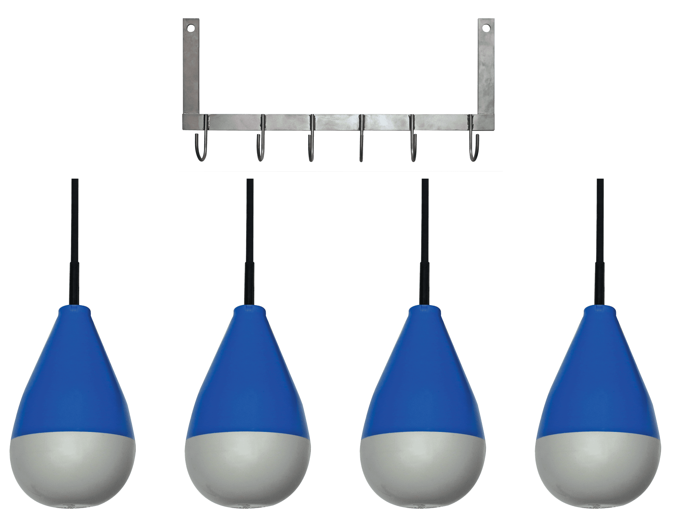
Controls

Slide 18
Clean Level Control Devices
Floats – Wash & Wipe them down
Probes – Wipe them down
Transducers – Wipe them down
Ultrasonic – Clean the sensor face
**Always check your equipment’s O&M manual for proper cleaning instructions

Slide 19
Check Control Panels
Check for loose wires, burnt wires or moisture in the control panel (With the power off)
Check for corrosion in the panel due to Lift Station Gases
Ensure run lights are working properly by turning the HOA switch in to hand
Flip all of the floats over to ensure the alarm or backup system is working properly.
Check Junction Boxes to ensure they are dry
Insulation Resistance Testing, also known as Meggering the motor, tests the integrity of the motor windings, which gradually break down.

Slide 20
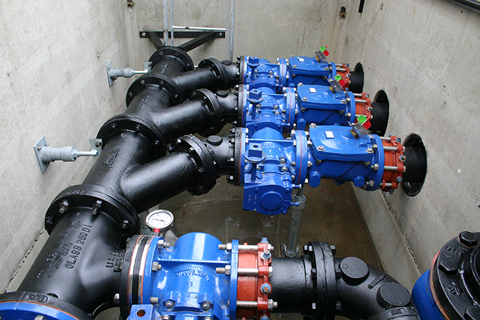
Piping

Slide 21
Things to check
Run the station down to the bottom to expose all flanged connections and check for leaks
Disassemble & Clean Check Valves – If you can
Clean Air Release Valves

Slide 22
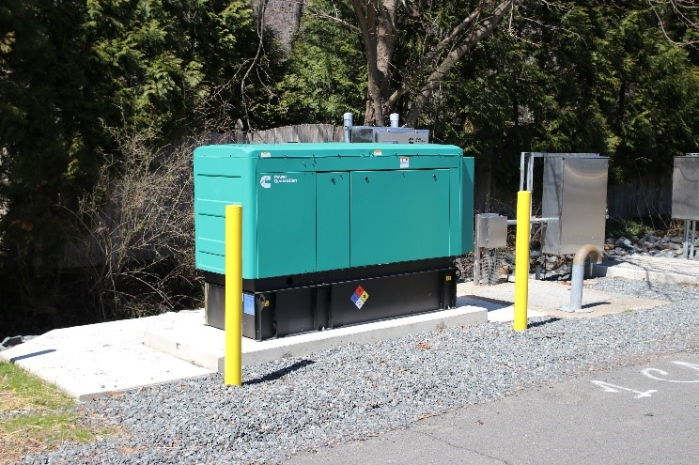
Generators

Slide 23
What to check for
Fresh Fuel – is it gasoline, diesel, or propane/natural gas
Oil
Filters
Battery
**Consult your O&M Manual for operational checks. Most generators associated with Lift Stations have a timer that automatically exercises the generator. If not, the generator should be manually operated on a schedule.

Slide 24
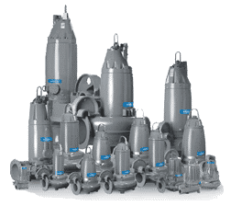
Choosing the Right Pump

Slide 25
How Critical is the Station?
Stations with high flow rates that see a lot of debris will most likely require a premium Pump.
The risk of using an economical pump may be practical on stations with low flows and low use.

Slide 26
What’s the difference?
Mechanical Seal Material – Silicon vs Tungsten
Motor Insulation – Class H vs Class F
Impeller Material – Bronze, Stainless, Cast Iron, Hard Iron
Construction of the pump

Slide 27
Come see us in action.
Take a video tour of our service capabilities
https://youtu.be/erjEIfTsvpA
Let us customize a PM program for your system or plant.

