Slide 1






The Whys and How of SOPs
Jeff Oxenford, joxenford@rcap.org
Cindy Goodburn, cindy@cgoodburnconsulting.com
Notes:
Add regional logo in picture frame at lower left

Slide 2
Notes:
RCAP is a non-profit organization providing training and technical assistance to rural communities & tribes on drinking water, wastewater, and solid waste issues.
We have approximately 200 field staff, including certified operators and professional engineers. Our staff members have expertise in drinking water and wastewater treatment & operations, utility financing, management, & general administration.
We work in all 50 states, plus five U.S. territories.
We are comprised of 6 regional offices & one national office.
RCAP is funded by federal grants (USDA, HHS, EPA) and state grants.

Slide 3

SOP Cooperative
25 utility members
Library of over 1000 SOPs
Example templates and other tools
Program for jump starting SOP development

Slide 4
Definition -Standard operating procedure (SOP)
Set of written instructions that document a routine or repetitive activity followed by an organization. (EPA, 2007)

Slide 5
Goals for today
At the end of today:
Understand the why? Why SOPs are important
Template
List of SOPs and priorities
SOP for SOPs

Slide 6
Why SOPs
Why should you invest the time and effort in developing SOPs?

Slide 7
Top Drivers
Consistency
Continuity (capture knowledge)
Efficiency/ productivity
Safety
Regulatory???

Slide 8
Are SOPs required?
Operations and maintenance plan (Sanitary survey)
Delegation plan
Emergency response plan
State revolving funds (SRF) loans

Slide 9
From CDPHE FAQs
Is There A List Of Tasks That Is Considered The Most Important To Have Defined In The Operating Plan?
No. There is not a specific or prioritized list. All delegated tasks or activities that could affect water quality or quantity, effluent quality or quantity, or the facility’s integrity must be included in the operating plan. This may include routine tasks involved in daily facility operations, or tasks that are completed in an emergency and found in the emergency response plan.

Slide 10
Other Drivers
Permit compliance
Reducing liability
Training and cross training
Communications
Value measurement
Accountability

Slide 11
Audiences
Who are you writing SOPs for?

Slide 12


Audiences
Internal audiences
Operations
Engineers
Laboratory
Upper management
External audiences
Contractors
Regulators
Other departments
Interconnects and other agencies
Different needs
New employees
Infrequent tasks (seasonal)
Regular tasks - regular crew
Different crews
Standby operations (back-up operator)
As part of a safety program

Slide 13
Challenges
What’s making SOP development so hard?

Slide 14
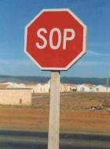
Top Challenges
Other Challenges
Who writes them? Subject matter experts are not always writers.
There is no dedicated person
Bureaucracy and multiple approvals needed
Analysis paralysis
Fear in not accurately capturing steps, fear of writing, and fear of new technology.
Resistance to writing and/or using SOPs
Getting started, a daunting task
Prioritization
Time and resources
SOPs are often backburnered
Getting people to use the SOPs
Getting buy-in and understanding value

Slide 15
Rate where you are with SOPs?

Slide 16
Four Steps in Developing Effective SOPs
Identify format to use – Template
How many SOPs are needed?
What process should be used to develop and maintain them? SOP for SOPs
Training

Slide 17
1. SOP Templates
Consider information to include in SOPs
What’s required information?
What’s needed for certain types of SOPs only?
What’s nice to have?
What are items that don’t need to be there?
Consider innovative formats

Slide 18
Required Information
Consistent header with
Title
Contact (author and/or subject matter expert)
Effective date (and revision dates)
Document location
Purpose – (also referred to as Background or Objective)
Safety issues - unique for the specific SOP
Procedure – Step-by-step
Resources

Slide 19
May be required (depending on the type of SOP)
Documentation – Data forms, record keeping requirements, etc.
Equipment
Roles
Regulatory requirements
Troubleshooting guide

Slide 20
Nice to have
Definitions
Disclaimer
Lessons learned, historical info
Tables, flowcharts, or descriptive icons
Videos
Links to other SOPs/documents
Humor
Review and distribution

Slide 21
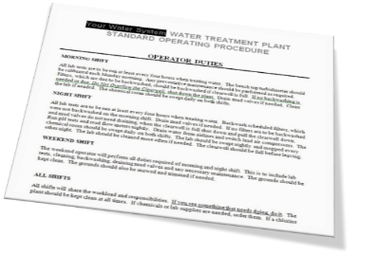
What to leave out
Policies or procedures that are general in nature
Lengthy program descriptions that are recorded elsewhere
Outdated information

Slide 22
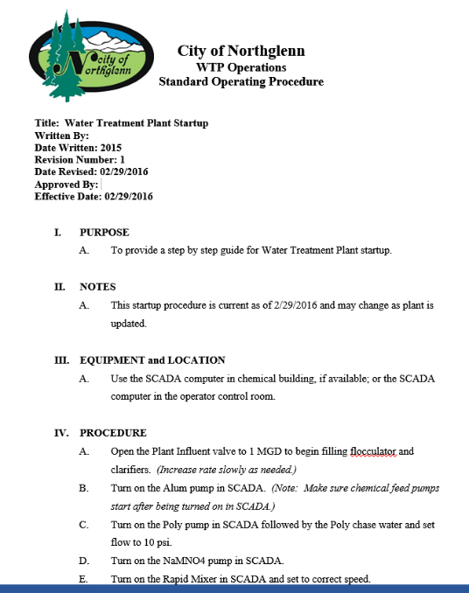
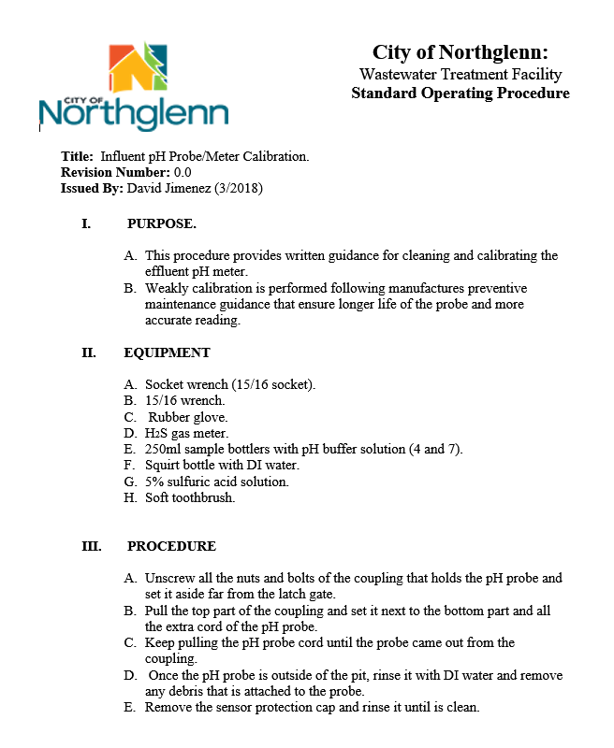

Slide 23
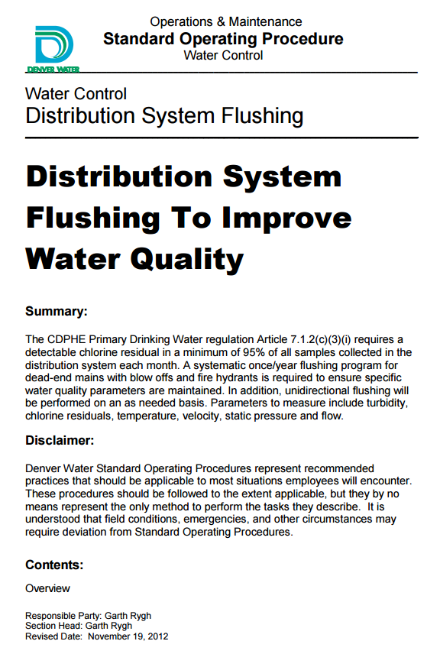
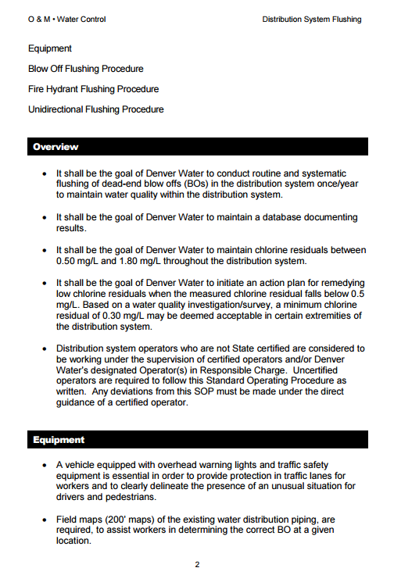

Slide 24
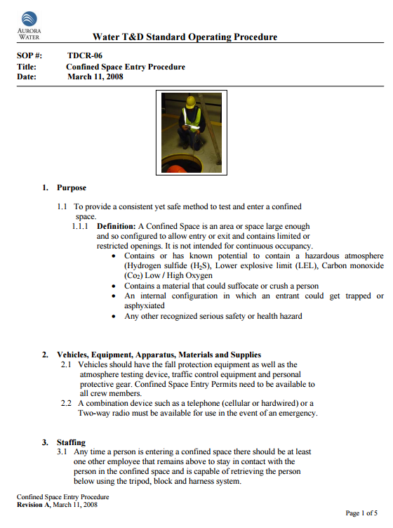
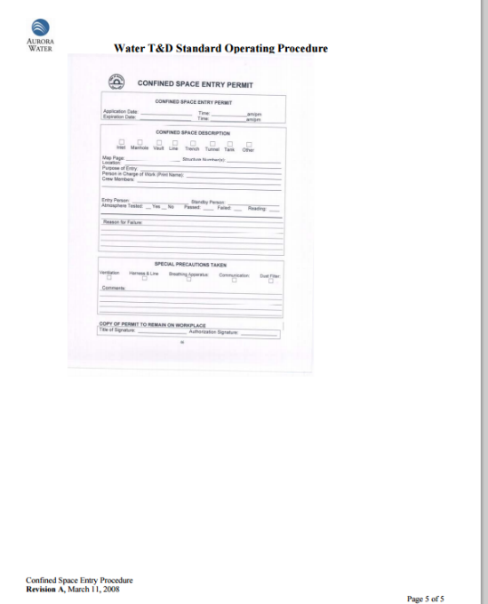

Slide 25
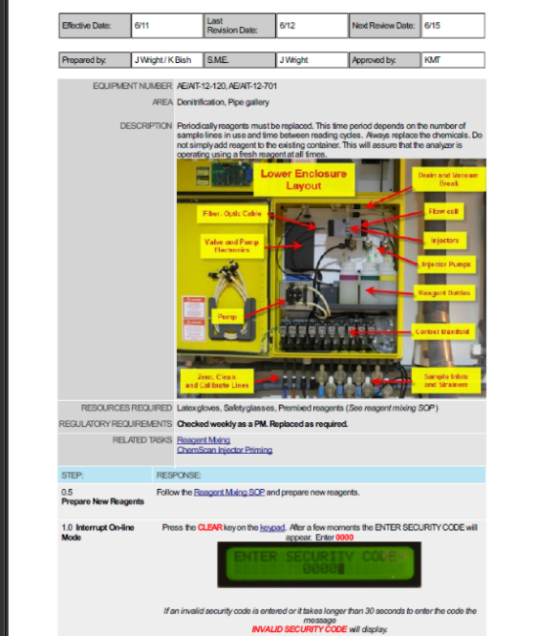

Slide 26
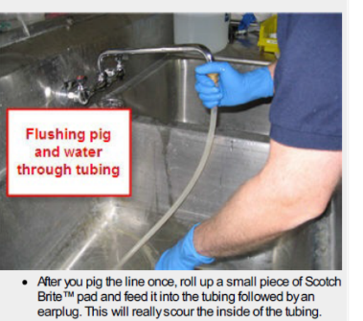
Using labels:
Cleaning Sampler Tubing Example
Notes:
CLEANING SAMPLER SUCTION TUBING
Labels add essential information

Slide 27
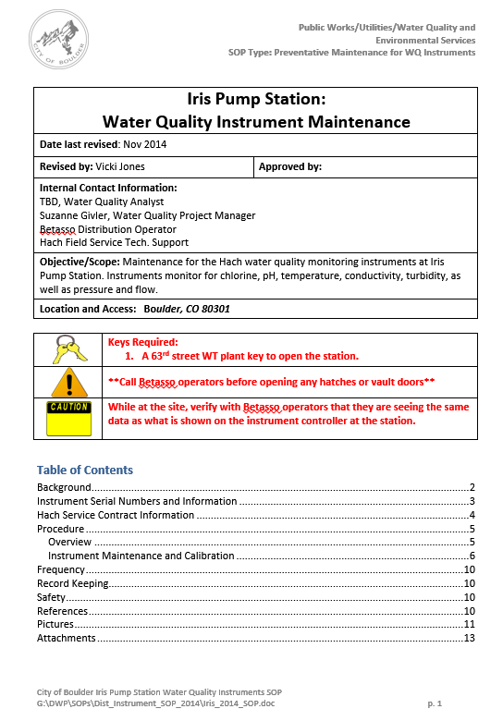
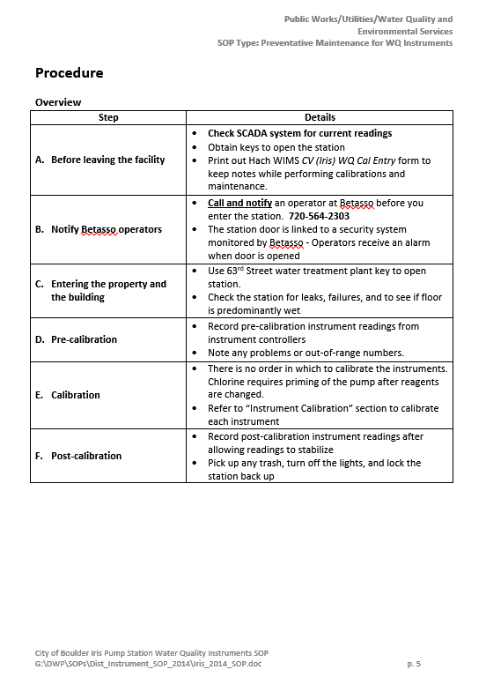

Slide 28
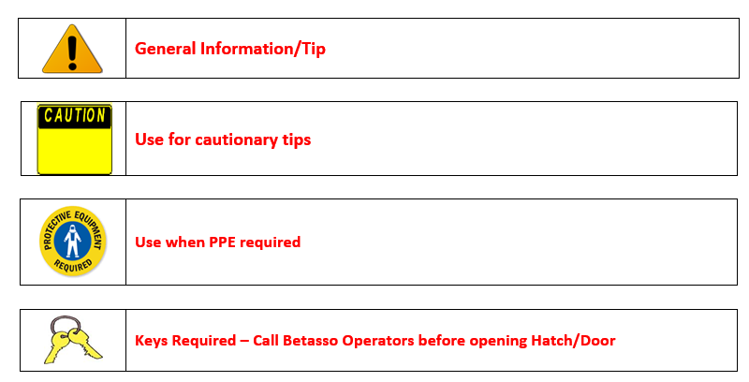

Slide 29
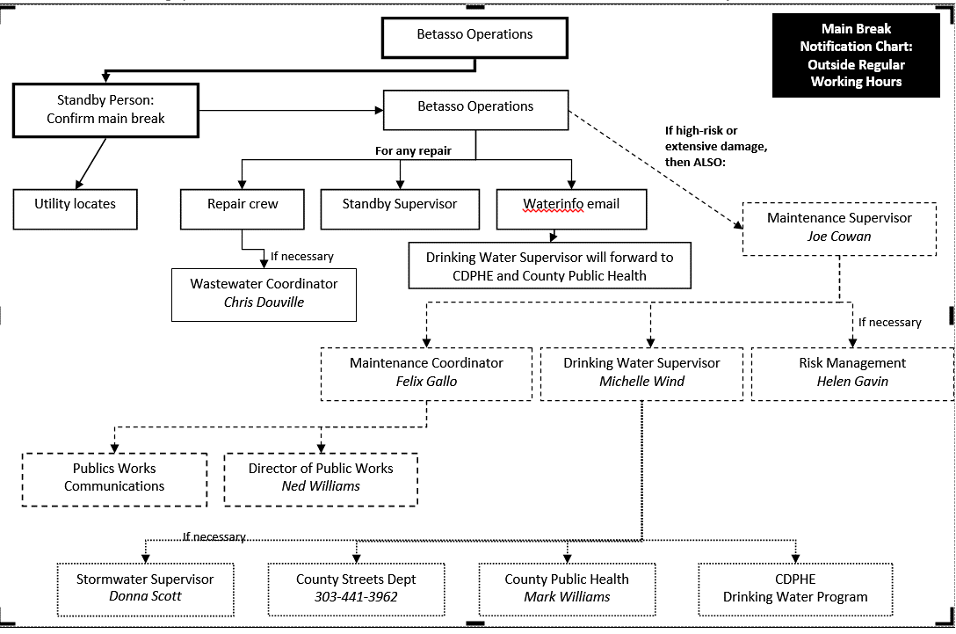

Slide 30
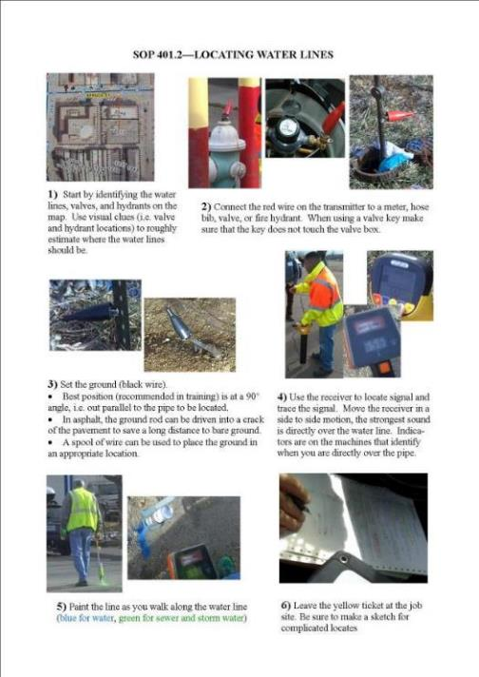
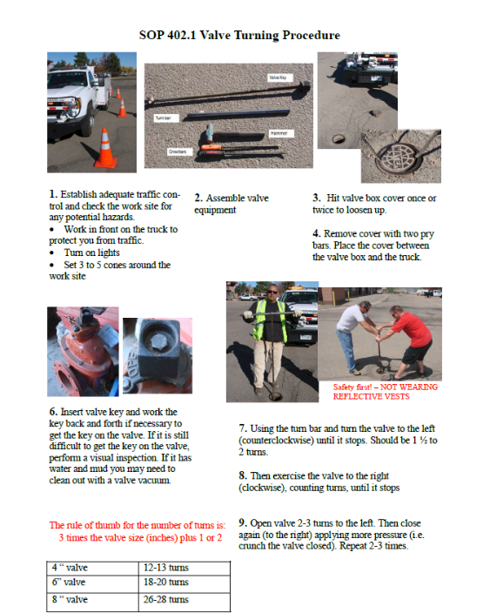

Slide 31
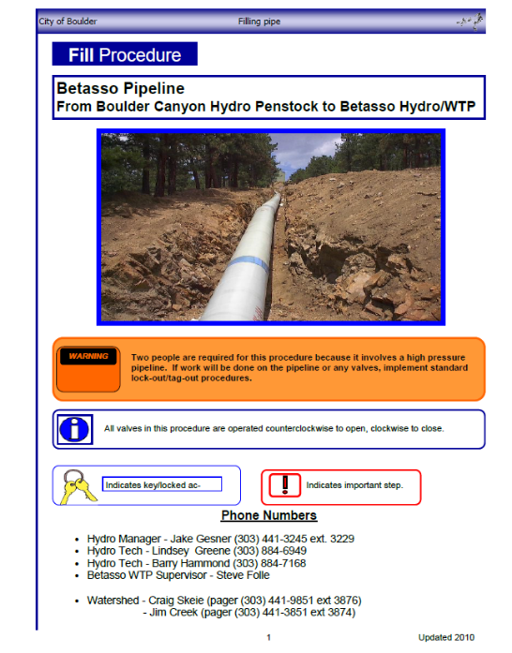
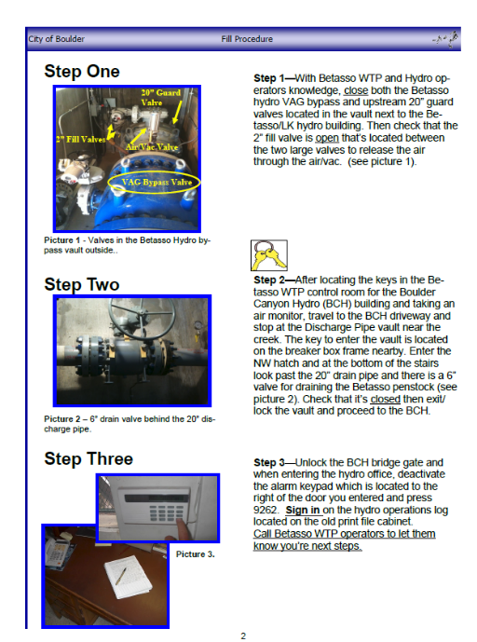

Slide 32
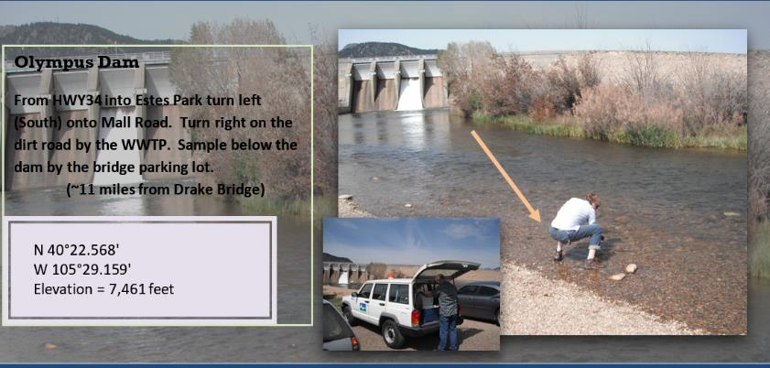
Descriptive pictures: Algae sampling locations
Notes:
SOP Estes Algae GPS & Directional Guide September 2012 booklet.docx
Highlight – directions, GPS – use of labels and descriptive tags
Anecdote – Loveland internal staff review revealed that the sampling location was in the wrong spot.

Slide 33
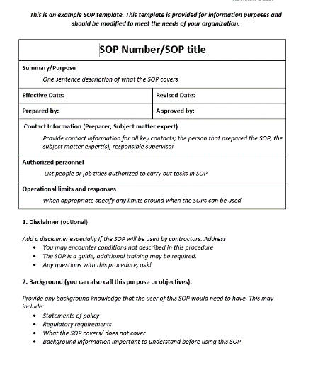
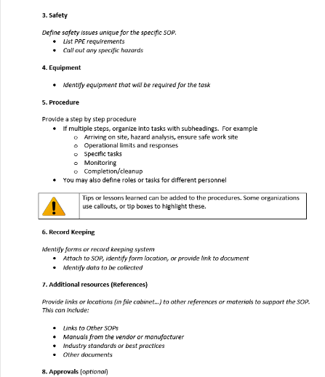

Slide 34
2. What SOPs do we need and how many?

Slide 35
How to identify which SOPs are needed?
By task
Common tasks
Infrequent or seasonal tasks
Critical task
Following the process train
Regulatory
Core SOPs
SOP that every utility has (should have)
A place to start in your

Slide 36
SOP Cores
Water distribution systems
Wastewater collection systems
Preliminary wastewater treatment
Water treatment (draft)

Slide 37
Water distribution core
Hydrant - Inspection and maintenance
Valve exercising
Hydrant – Flushing (corrective)
Responding to low chlorine residual
Disinfectant residual sampling
Taking a coliform sample
Responding to low pressure
Storage tank inspection
Water main break
Safety

Slide 38
3. SOP for SOPs

Slide 39
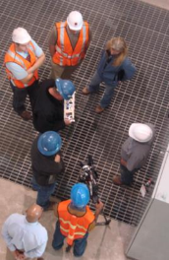
Identifying responsibilities (who)
Who prepares, reviews, approves
Subject matter expert
Team
Consultant
Supervisors/ managers
How is this reflected in job responsibilities?

Slide 40
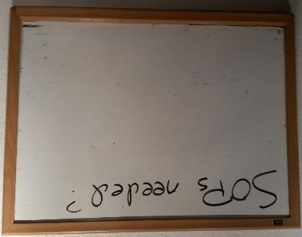
Selecting which SOPs to develop (what)
How are SOP needs identified?
How are SOPs prioritized for development?

Slide 41

Developing (when)
Timeframe and schedule for developing SOPs
Updating
How often?
By whom?
When mistakes are found, what process is in place for correcting?
Retiring out of date SOPs

Slide 42

Storing and communicating (where)
How are SOPs stored and managed?
How are they made available to staff? In the field?

Slide 43
Example of SOPs in Action

Slide 44
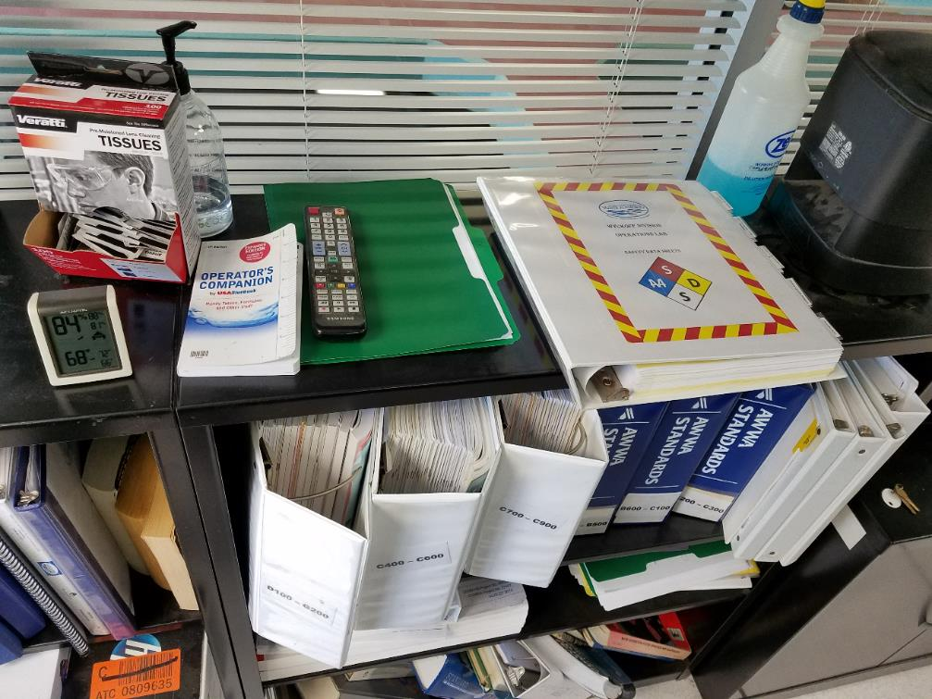

Slide 45
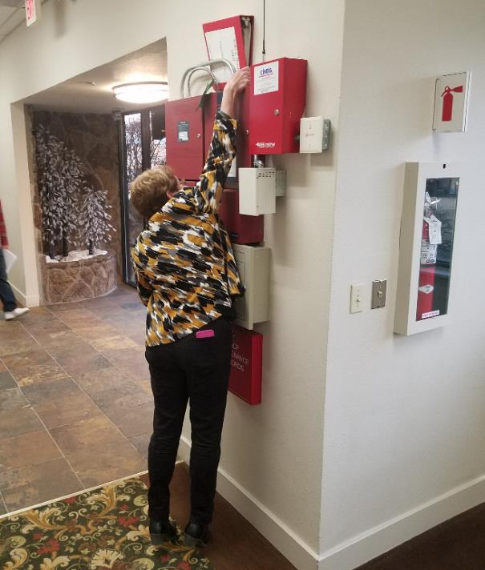

Slide 46
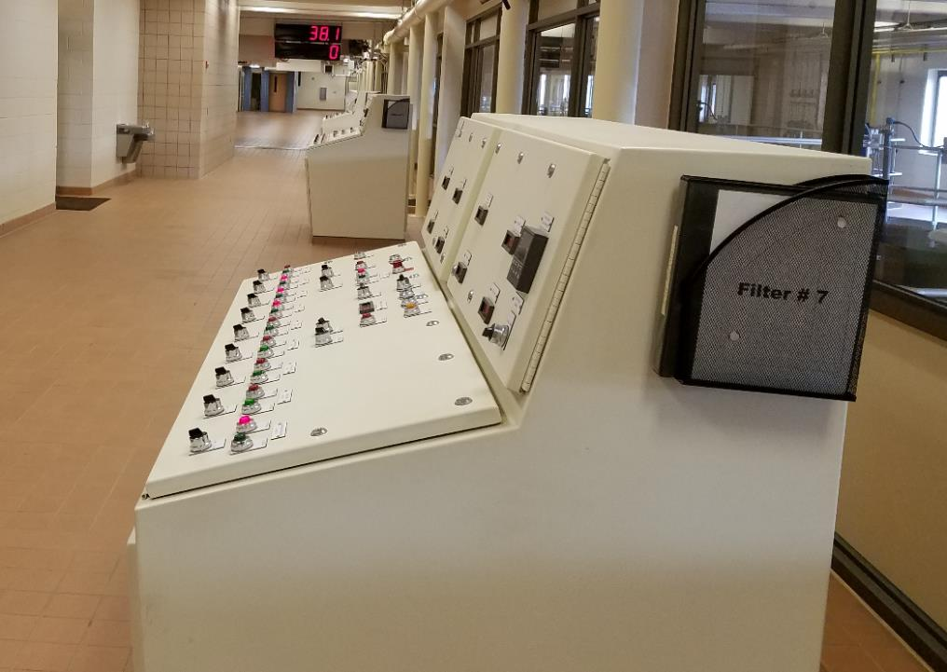

Slide 47
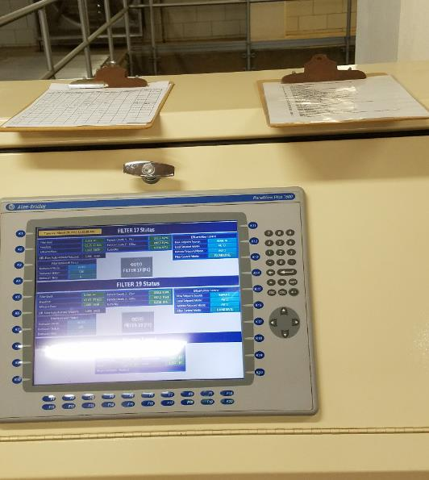
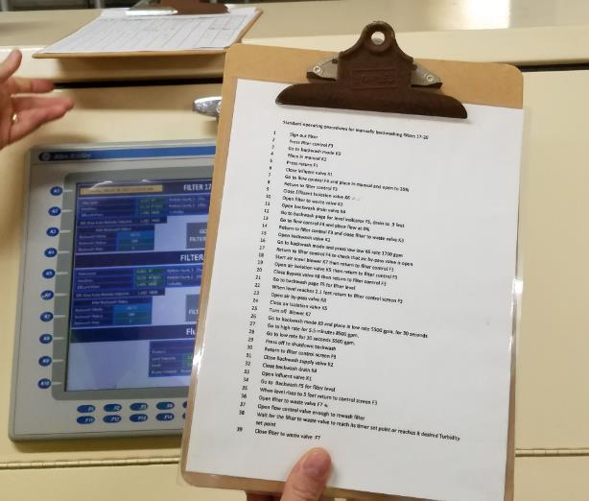

Slide 48
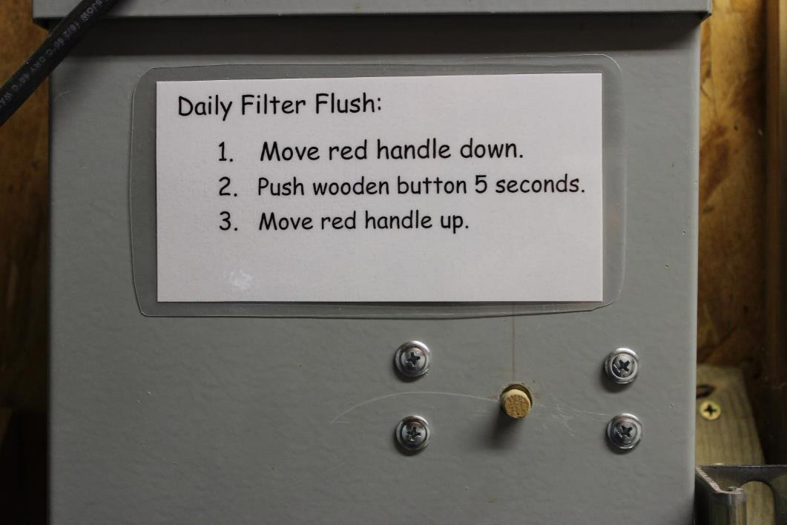

Slide 49
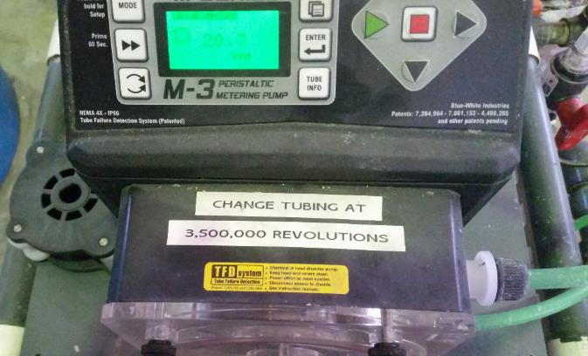
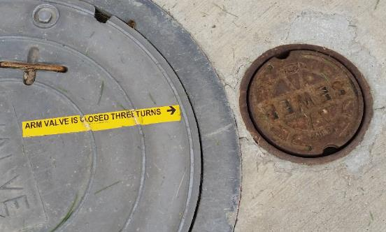

Slide 50
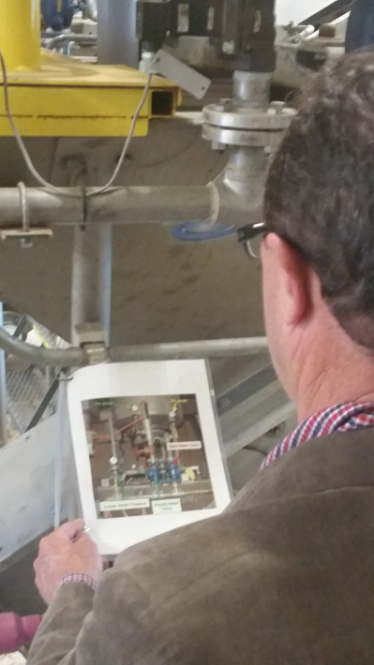
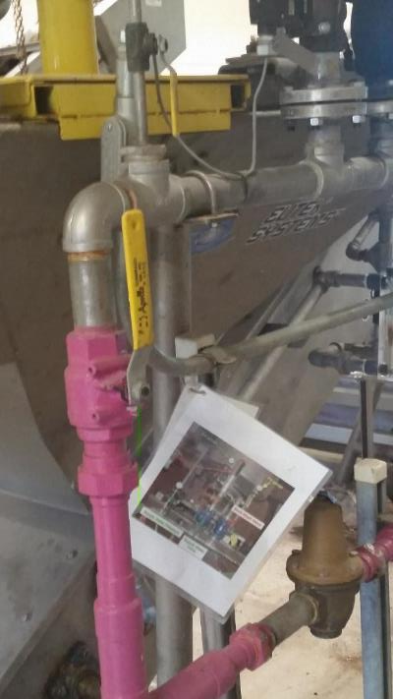

Slide 51
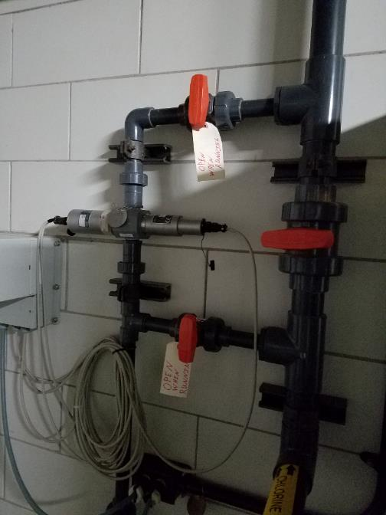
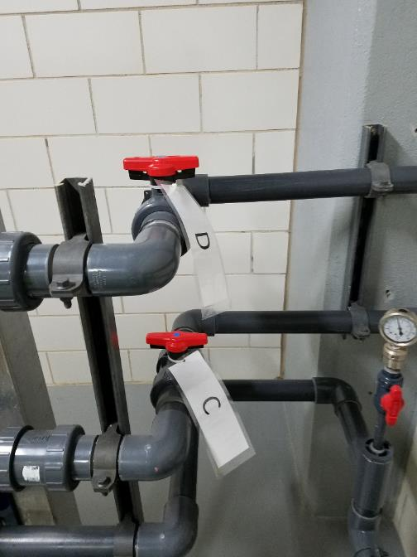

Slide 52
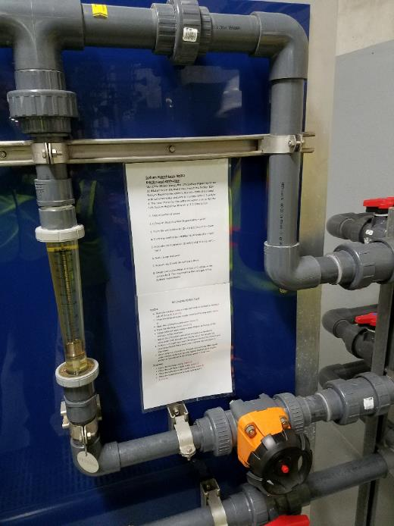
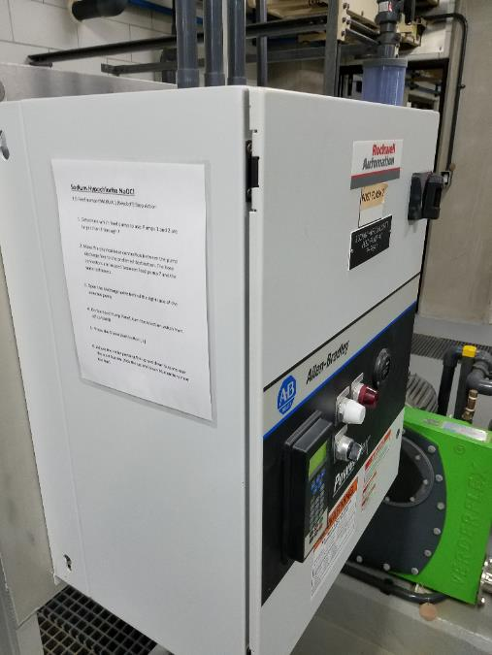

Slide 53
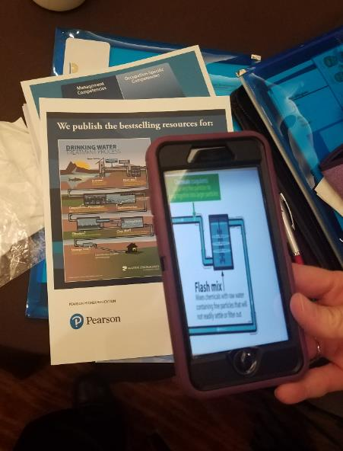


Slide 54
Contact information
Jeff Oxenford
joxenford@rcap.org
(303) 917-5382
SOP Cooperative
Cindy Goodburn
cindy@cgoodburnconsulting.com
Mobile: 303-435-1104

